Slide 1

Flight Route Analysis – US Flight Delays
Data Visualization Course
Presented by Data Drifters
Christine Tadiwanashe Dzimbanhete
Nicolette Mtisi
Sirivennela Immadi
Ruvarashe Cynthia Mabika

Slide 2
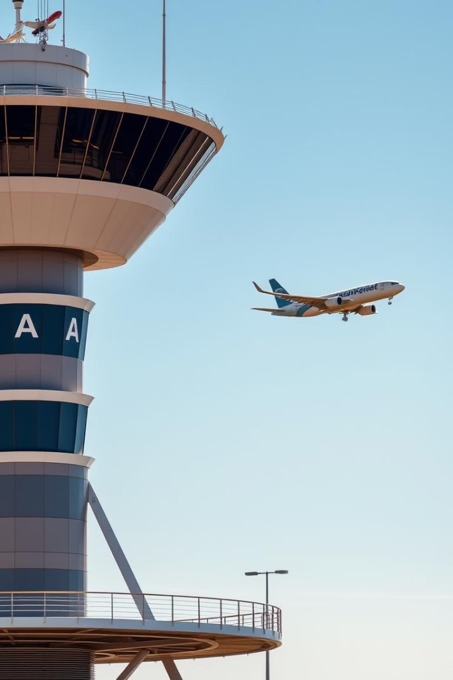
Stakeholder Overview & Objective
Stakeholder: Federal Aviation Administration (FAA)
Frequent delays disrupt airspace efficiency
Negative impact on passenger satisfaction
Compliance challenges with passenger rights regulations
Objectives:
Identify patterns in delays and cancellations
Improve airline scheduling and operations
Enforce better airline accountability

Slide 3
Dataset Summary
Data Source: US Domestic Flights (2018)
Records Analyzed:
3.8 million scheduled flights
Key Fields:
Carrier, Origin/Destination, Delay Minutes, Cancellation Reason, Month, Day of Week

Slide 4
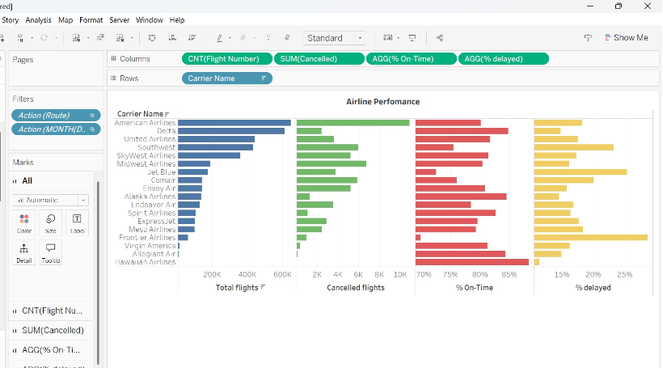
Airline Performance Overview
Bar chart compares airlines by total flights, cancellations, on-time %, and delay %
ExpressJet and JetBlue show highest delay % and lower on-time performance
FAA can focus audits on carriers with subpar metrics

Slide 5
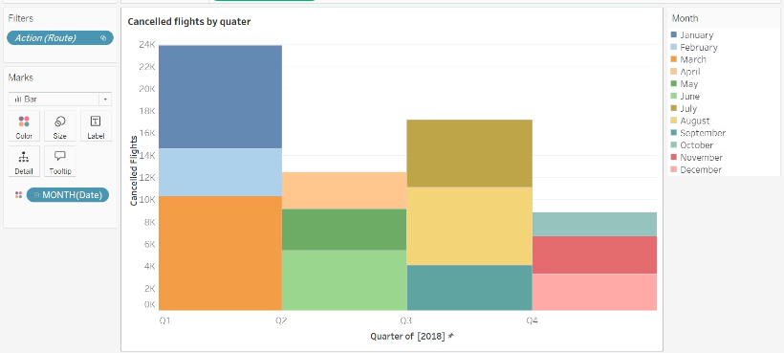
Cancelled Flights by Quarter
Q1 shows the highest cancellations, likely due to winter weather
Summer months show a rise likely due to turbulence while Q4 has lesser cancellations.
FAA and airlines should enhance seasonal scheduling strategies

Slide 6
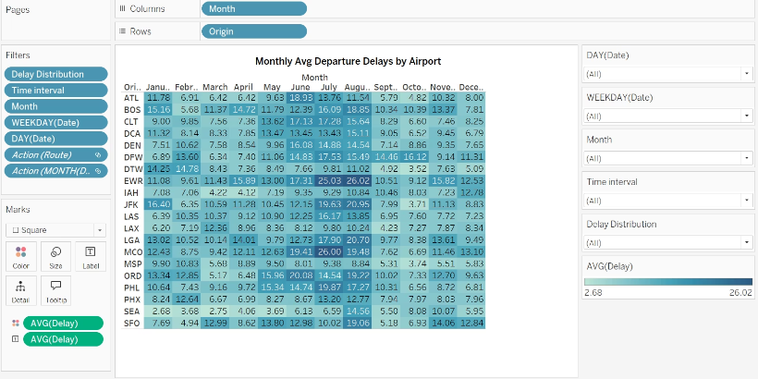
Monthly Avg Departure Delays by Airport
Heatmap shows monthly average departure delays for key airports
BOS, JFK, and EWR consistently show higher delays
July and August have longer delays across most airports
Helps FAA prioritize airport-level policy and operational improvements

Slide 7
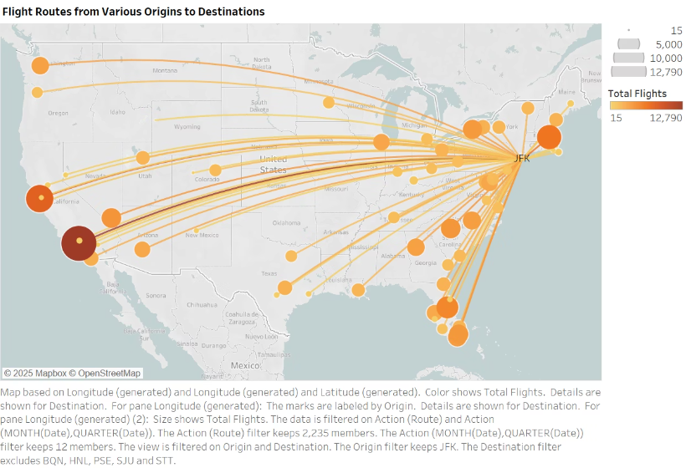
Flight Routes from JFK – Spider Map
Visualizes flight traffic volume from JFK to destinations across the US
Thicker and darker lines represent higher traffic routes
JFK–LAX and JFK–SFO are some of the busiest routes
Useful for identifying congestion points for FAA air traffic control optimization

Slide 8
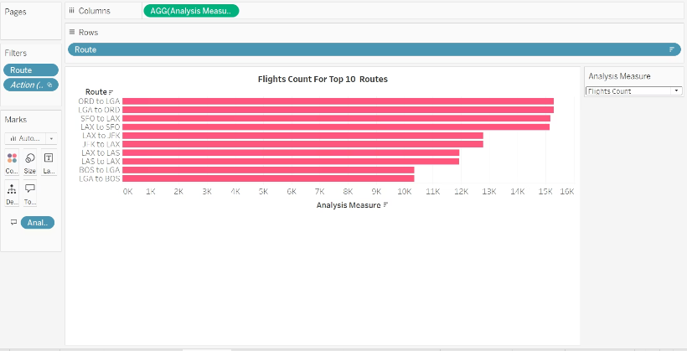
Most Flown Routes – Flight Count
ORD–LGA, SFO-LAX and LAX-JFK are the most flown routes
Routes with high volume are more vulnerable to cumulative delays
Potential areas for FAA to improve flow and reduce congestion

Slide 9
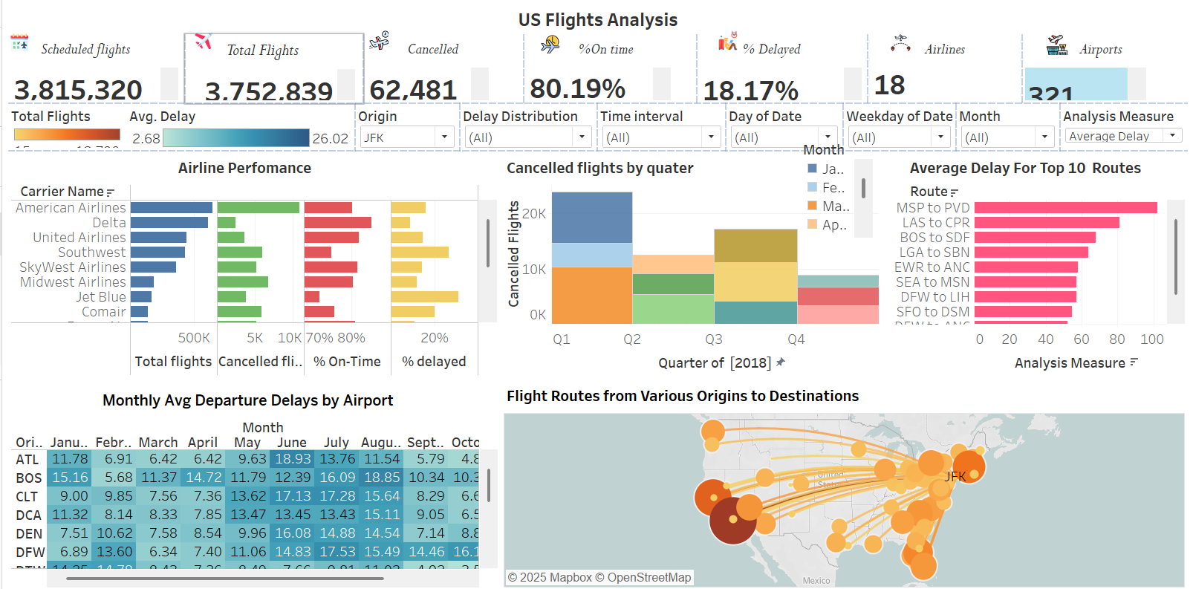

Slide 10
Key Recommendations
Prioritize delay-prone routes and investigate root causes
Optimize flight schedules on high-traffic corridors (e.g., ORD–LGA)
Implement seasonal contingency plans for Q1 and Q4
Address operational inefficiencies at high-delay airports like BOS and JFK
Hold low-performing airlines accountable through audits
Enhance passenger experience through real-time insights and rights enforcement
Maintain a monthly update cycle for flights, delays, and cancellations

Slide 11
Data Update Frequency Recommendation
Data Element
Recommended Update Cycle
Why?
Flight Volume and Delay Metrics
Monthly
Seasonal trends, airline schedules, and operational changes occur monthly.
Cancellations by Route
Monthly
Spot recurring disruptions quickly.
Airline Performance
Quarterly
Evaluate long-term patterns without overreacting to short-term noise.
Airport Delay Heatmap
Monthly
Provides insight into infrastructure/crew impacts across seasons.
Route-Specific Delay Trends
Monthly to Quarterly
Use monthly during busy seasons; quarterly for routine checks.

